Slide 1



NativeScript Workshop
Installation/Prep Instructions
Use my laptops: sit back and relax!
Use your own:
Windows: http://bit.ly/ns-win
Linux: http://bit.ly/ns-linux
OS X: http://bit.ly/ns-osx
Now you can mobile.

Slide 2


Slide 3
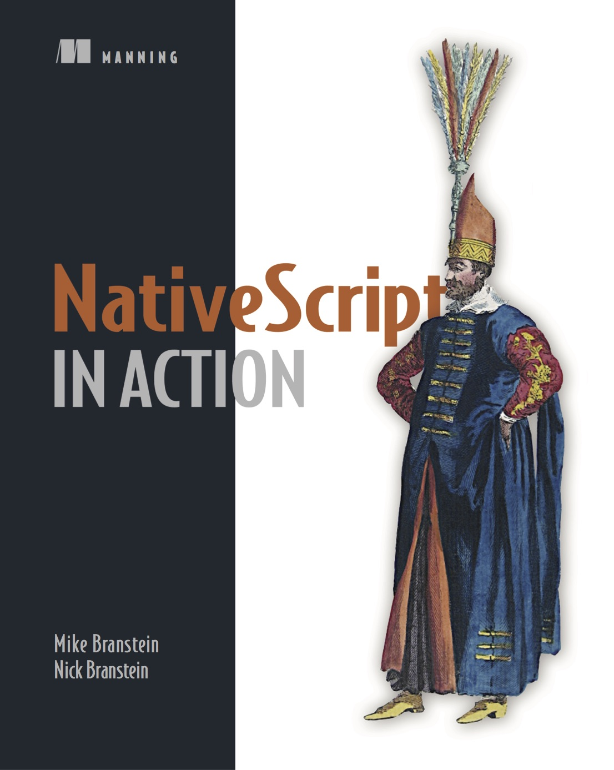
Mike Branstein
@mikebranstein
https://brosteins.com
@brosteins
http://bit.ly/nsinaction
40% off: ctwmcctw
http://kizan.com

Slide 4
Agenda
What is NativeScript?
~15 minutes
Hands-on workshop
~3.5 hours
Final Q&A
~10 minutes

Slide 5
Created and supported by Telerik
Notes:
I mention this because, in today’s world, where 10 JavaScript frameworks have been created since I started this presentation, that it’s important to pick an innovative and stable options

Slide 6
Delivering on the promise of “hybrid.”
Notes:
OK, what I want you to come away with today is that there are options. A lot of options for mobile development. Native, Phone Gap/Cordova, Xamarin. I want you to also consider NativeScript, and I’ve got some fairly compelling reasons to consider NativeScript.
But let’s talk about hybrid mobile development first. What is the promise of hybrid app development?

Slide 7
Hybrid Promise
100% Web
Hybrid
100% Native
Reach
Code/Skill Reuse
Richness
Premium experience
Device APIs
Best of both?

Slide 8
Early prototypes
“Core” engineering
Public launch
Adoption ramp-up
Mass adoption
2013
2014
2015
2016
2017
Project Timeline

Slide 9
NativeScript is…
an open source framework for building truly native mobile apps with JavaScript. Use web skills, like JavaScript, TypeScript, Angular and CSS, and get native UI and performance on iOS and Android.

Slide 10
The {N} difference…

Slide 11
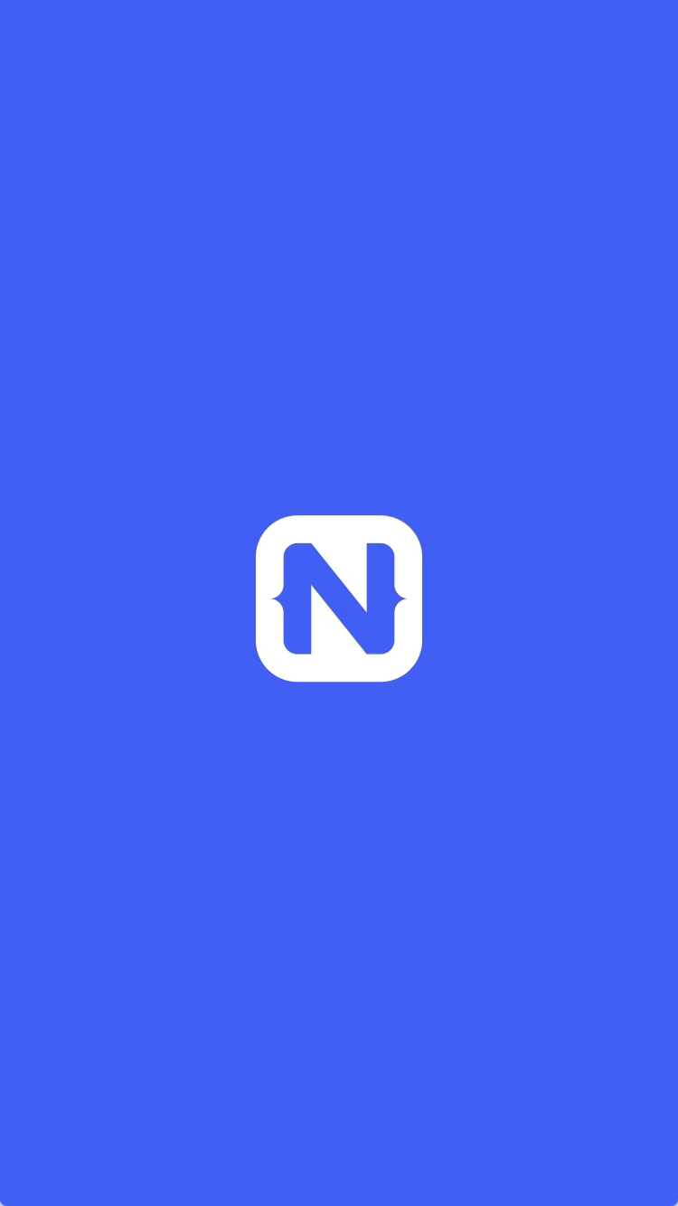
1
Rich, animated, “no compromise” native UI
(with shared UI code)
Search for
“Examples NativeScript”
in the iOS App Store or Google Play to try this out for yourself.

Slide 12
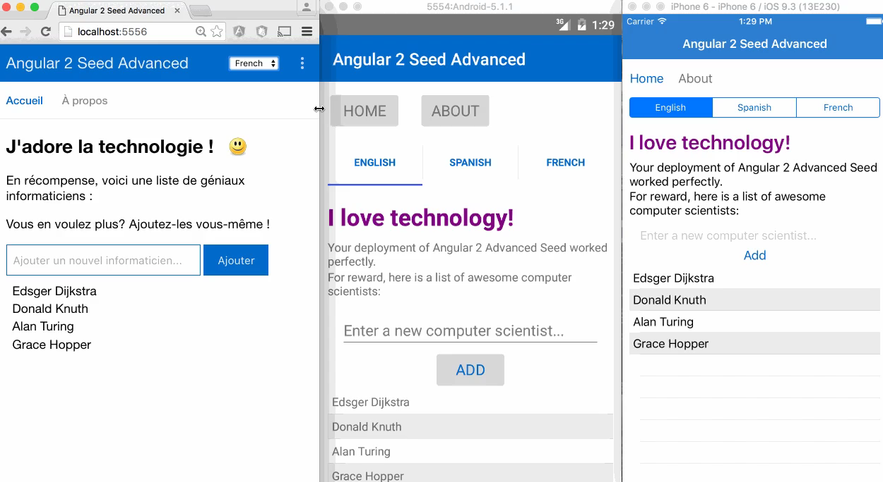
2
Maximum code and skill reusability
Video credit: Nathan Walker, {N} community member
Notes:
Npm, CocoaPods, Android Arsenal

Slide 13



3
First-class Angular and TypeScript support
+
=

Slide 14

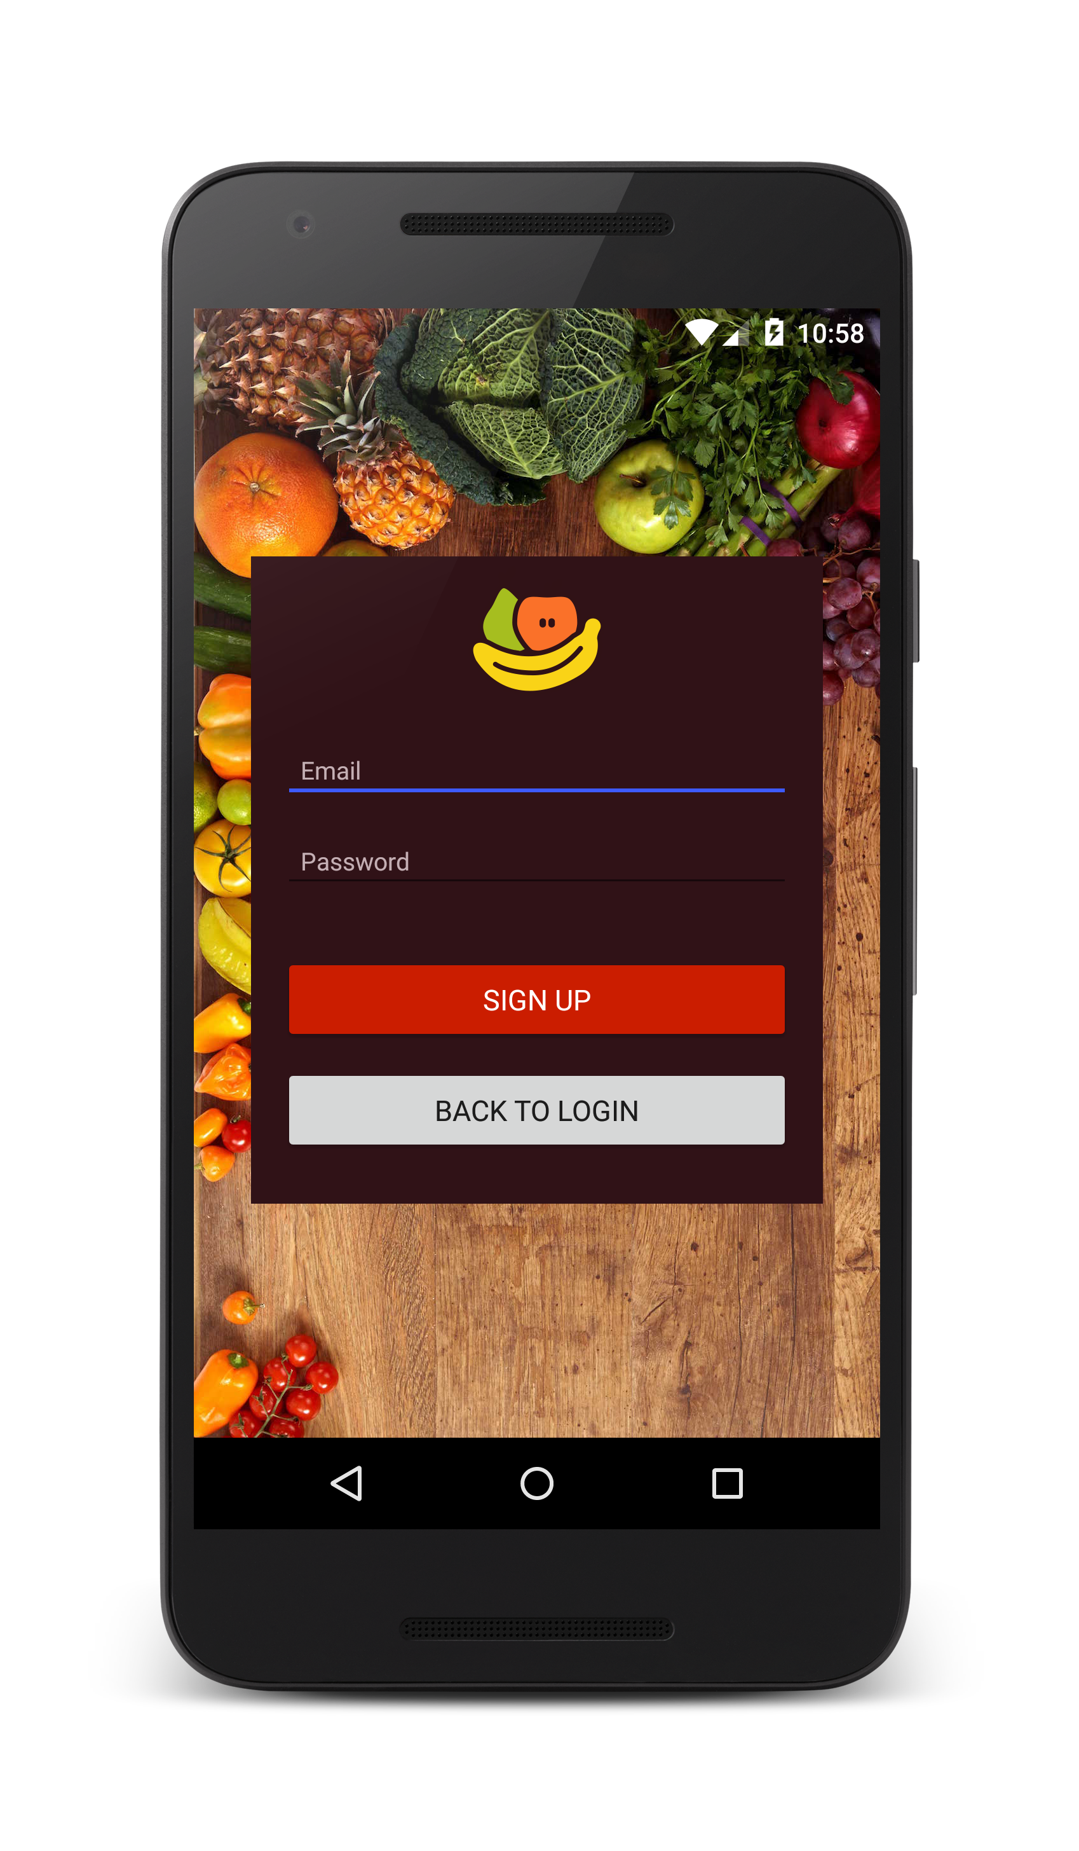

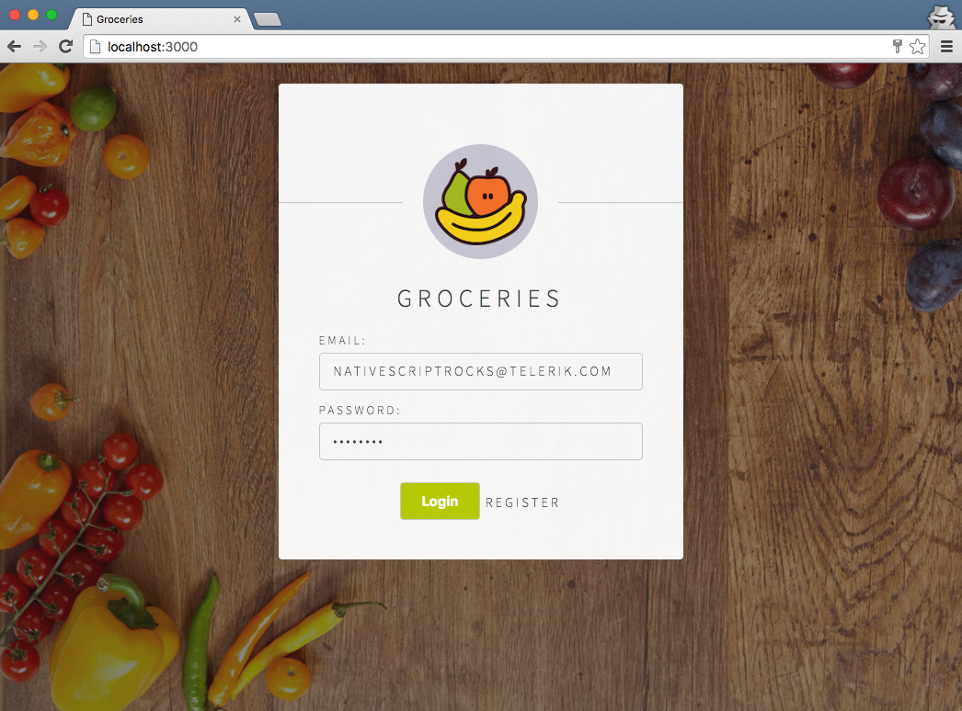
Android
iOS
Web
Notes:
Jen

Slide 15
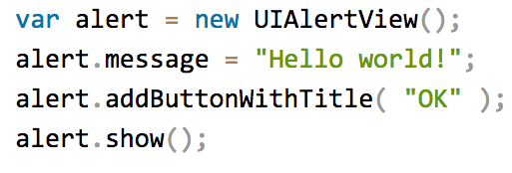
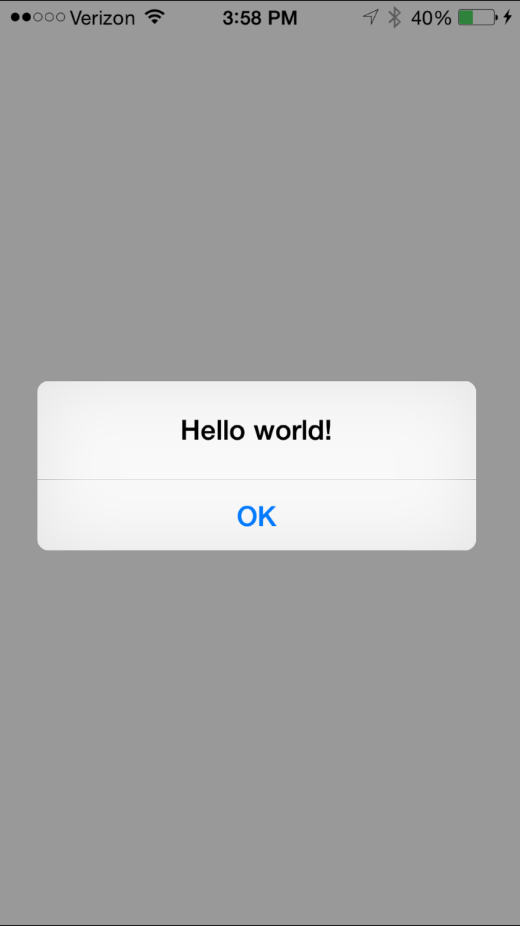
3
100% access to Android and iOS APIs
Notes:
Npm, CocoaPods, Android Arsenal

Slide 16
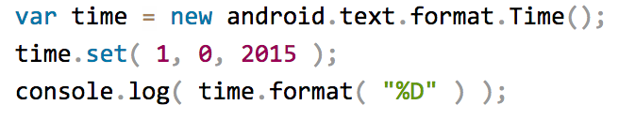


Runs on V8 JavaScript VM
Runs on JavaScriptCore VM
More details at http://bit.ly/how-nativescript-works

Slide 17
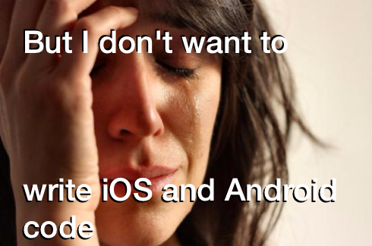
Notes:
That’s ok.

Slide 18
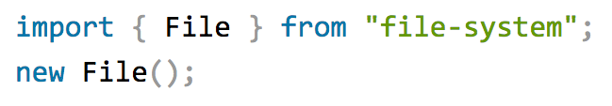



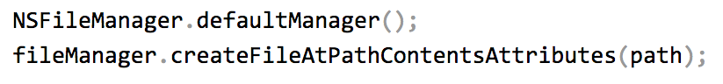
Example: NativeScript file module
Notes:
There is a set of core modules that abstract these things away for you, so you have a unified experience acorss the platforms, BUT if you really need to access Objective C and Java directly, that capabilitiy is always there.

Slide 19

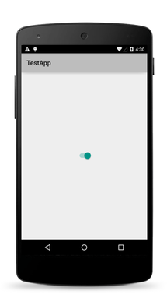
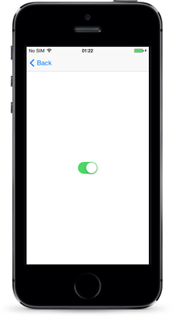
The same approach works for the UI

Slide 20
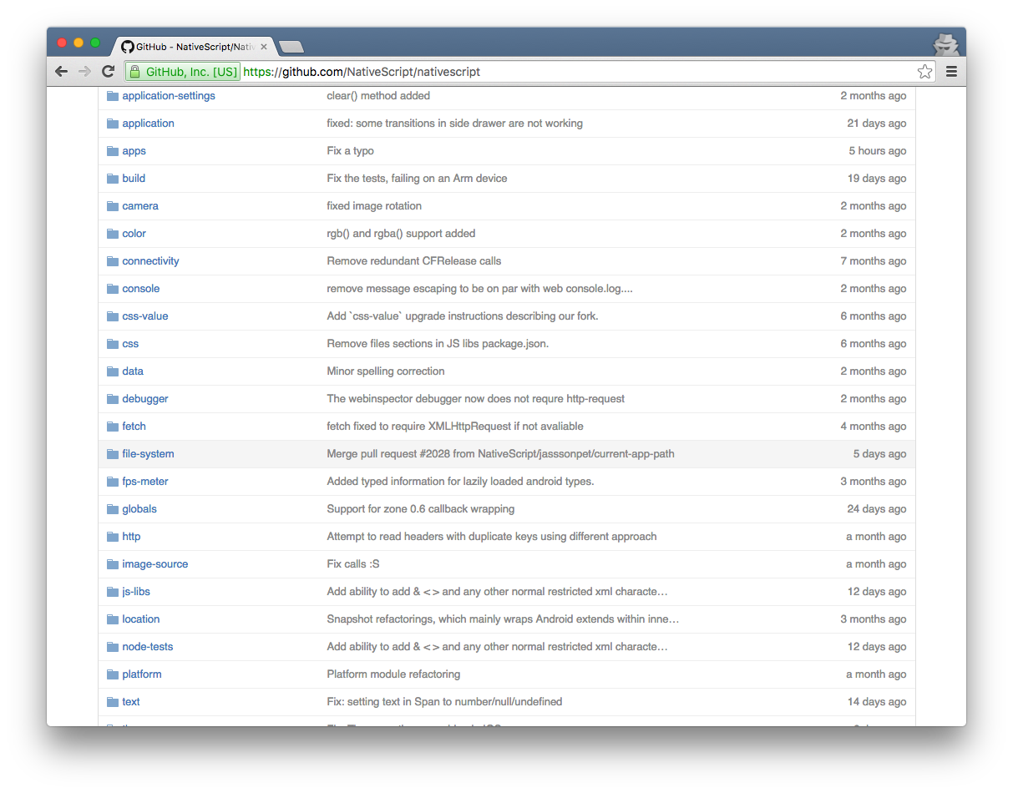
NativeScript Modules—There are a lot

Slide 21
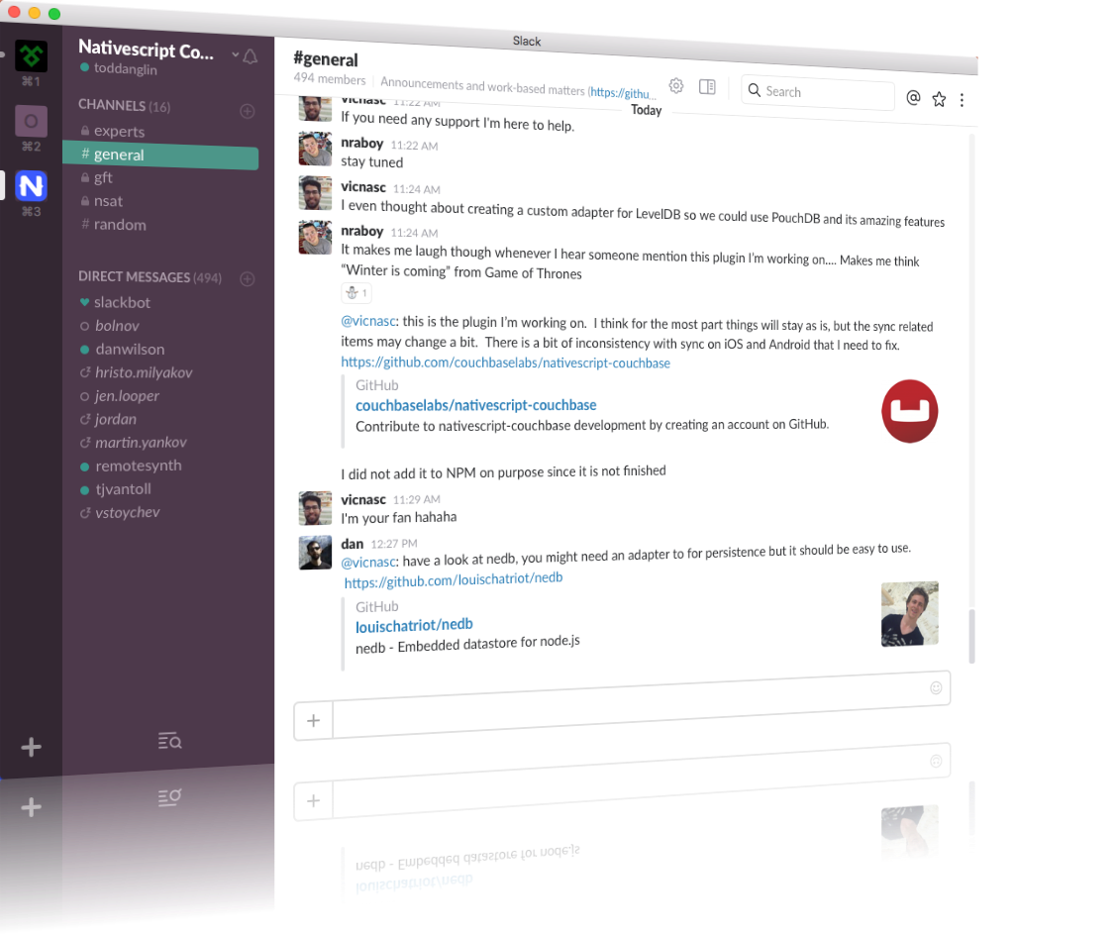
Join the growing NativeScript community on Slack
bit.ly/nativescript-slack

Slide 23
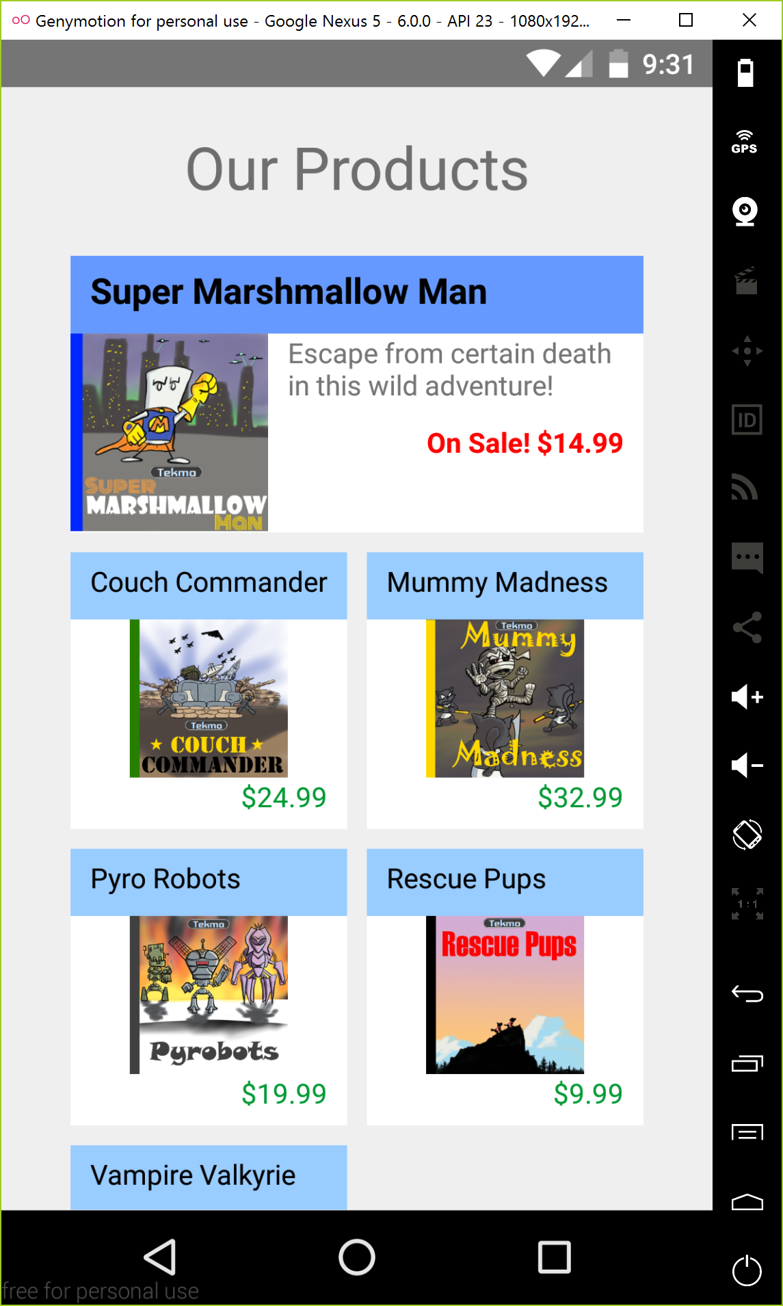
Hands-on workshop
Visit http://bit.ly/mcc-ns-workshop and Get Started!
What You’re Building
Fictional store front for a vintage video game company
Home
About Us
Contact Us
Products

